Slide 1
Overview of finance Trends
by Cory Kimbrough

Slide 2

Where does our profit come? Where does it wane?
Revenue Trends: April and November are the highest revenue months
Customer Value: Top 5% of customers contribute approximately 35% of total revenue
Product Profitability: Electronics generate the highest profit margins
Customer Retention: Repeat customers spend 2–3x more than first-time buyers
Cohort Analysis: Retention and revenue drop significantly after month 2 for most cohorts

Slide 3
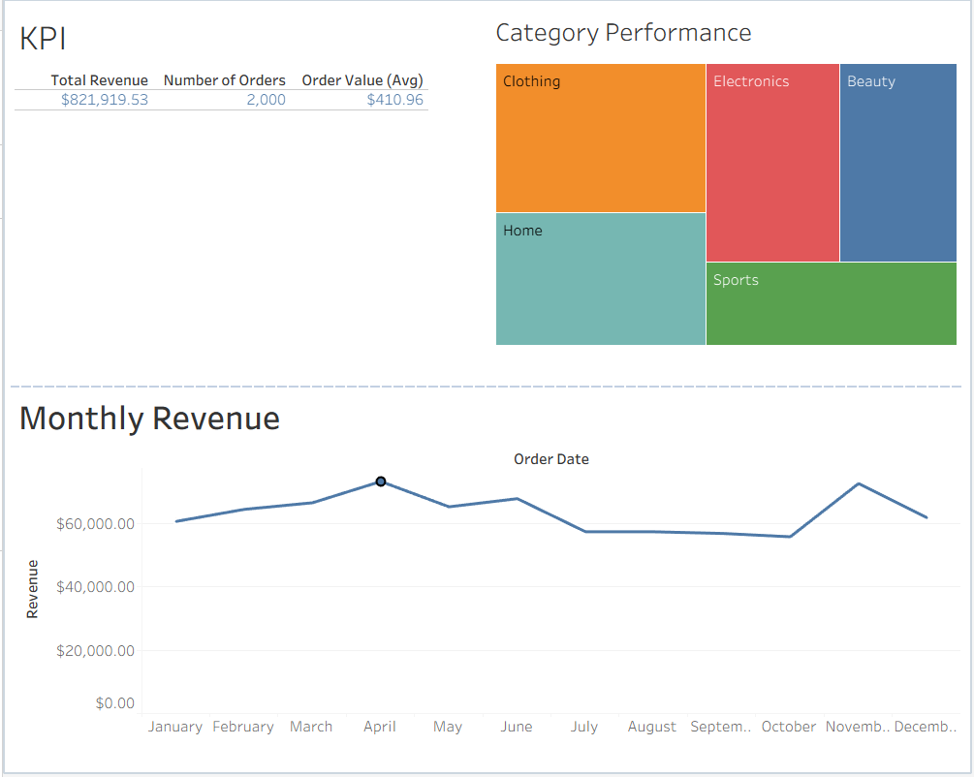
Notes:
Point out April and November as highest revenue, Explain what profit margins are and the category performance visual

Slide 4
boost profits: focus on electronics sales where it has the biggest profit margin.
focus on retaining customers: especially on attracting/retaining the big spenders as the top 5% give us a large 35% portion of our revenue.
Advertise extensively around the highest revenue times (to maximize our efforts).
Spend research efforts to determines why customers are weakening their spending after the initial period (survey, analysis).
Recommendations

Slide 5
Questions:
What exactly is making spending weaken after the first couple of months? (is there any interaction data?)
Is the revenue trend expected to be high for next April and November? If so, efforts should be put into more advertising and promotions centered around these times to maximize sales per advertising dollar spent. How can we confirm this? (more research, industry historical data highlights November and December as prime months for higher sales volume)
How can we increase repeat-business opportunities? (churn analysis?)
How can we keep and attract high-spending clientele? (survey?)

Slide 6

Thank you!
We appreciate you! Please feel free to offer any input or ask any questions as you would like. We love to hear new ideas and perspectives.
We should be working smarter, not harder! Your ideas and inputs help us become better.

